Slide 1
Consistent Estimation
Michael Pilosov
Solution Architect, Slalom Build | Data & Analytics: Machine Learning

Slide 2
Overview
What needs to happen to achieve a goal?
How do I stay on budget?
How do I allocate my time?
How can I make sense of all the possible answers?
Infinitely many solutions
Identify what is valuable

Slide 3
Architecture
Client-server architecture
CSV/JSON format
AWS Sagemaker/Lambda
Real challenge: user experience

Slide 4
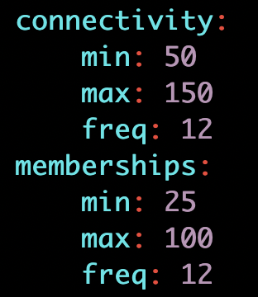
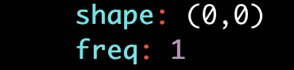
Schema
Optionals

Slide 5
Proposed Interfaces
Dashboard
Panel with list, click to edit item
Add/Remove
Question & Answer
Series of min/max questions
Prompt to “add another?”
Challenge:
Defining Product-Market Fit

Slide 6
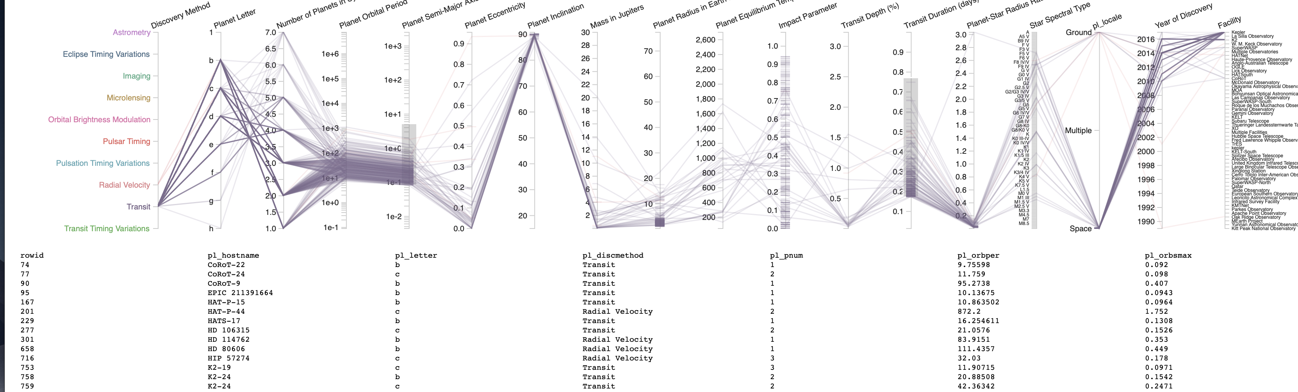
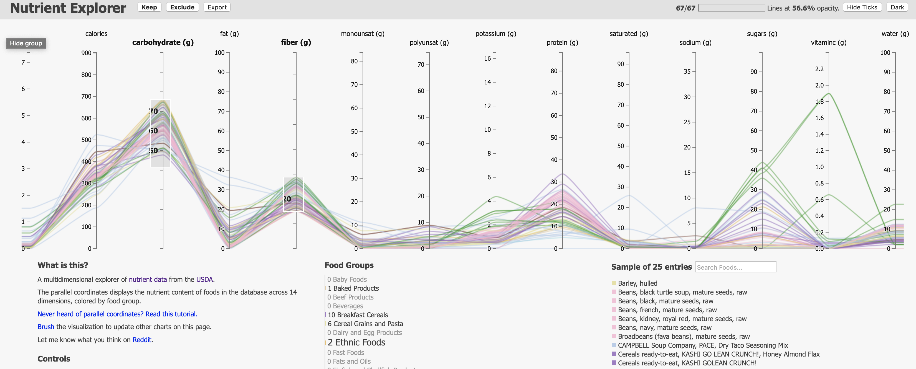
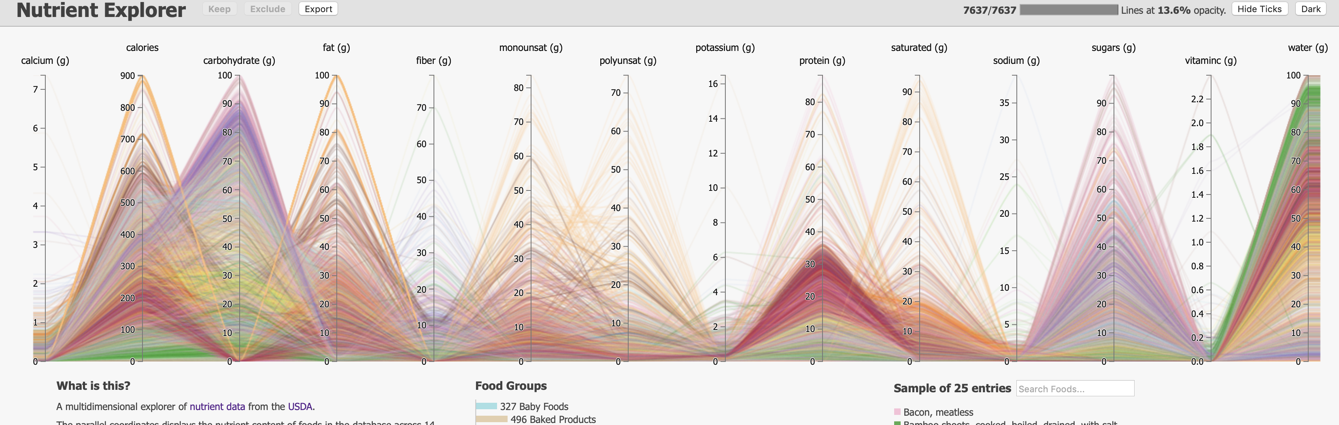
Processing & Results
Send request to server, get result back
Visualize result with (D3.js) web application
Allow export
Alternatively: user profiles, saved budgets, etc.

Slide 7
Next Steps
Work on visualization web application
Big potential for abstraction, re-use
General framework: high-dimensional data viz
Deploy model to AWS
Create UI/UX experience
Enable interactive data-entry for the model
Github.com/mathematicalmichael/dci-demo

